Slide 1

Enhanced Sales and Revenue Analysis
Presented by Jinwa Chinonso, Data Analyst
CJ
by Chinonso Jinwa

Slide 2


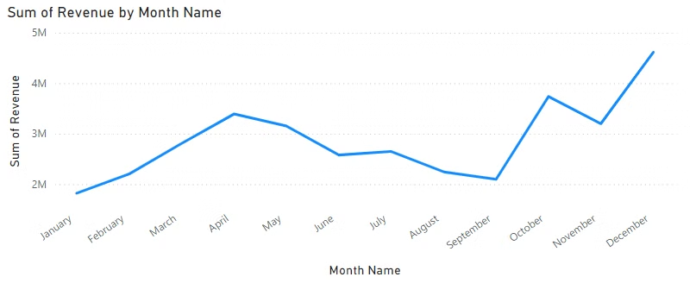


Revenue Trends Over the Year
December Peak
Revenue exceeds $4M
August-September Dip
Revenue below $3M
Action Plan
Targeted marketing to smooth seasonal dips

Slide 3

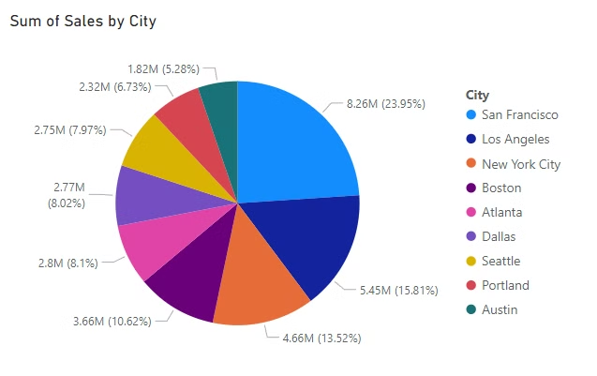
City-Wise Sales Analysis
$8.26M
$5.45M
San Francisco
Los Angeles
Top performer
Strong second
15%
Smaller Markets
Austin and Portland combined

Slide 4

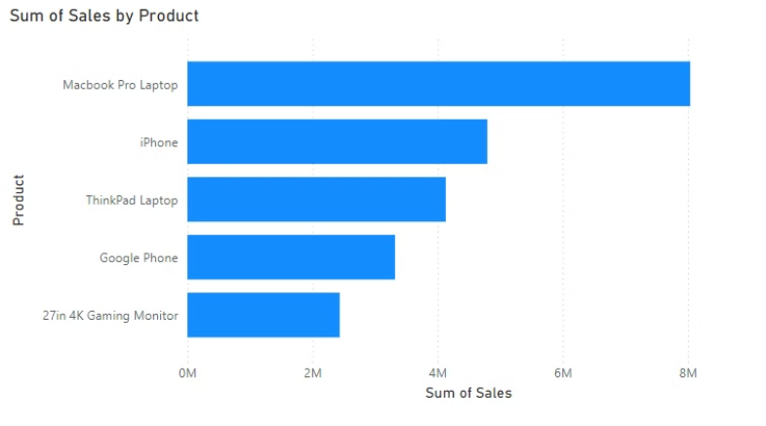



Top-Selling Products
MacBook Pro
1
$8M in sales
2
ThinkPad Laptops
Growth opportunity
3
Google Phones
Potential for promotion

Slide 5

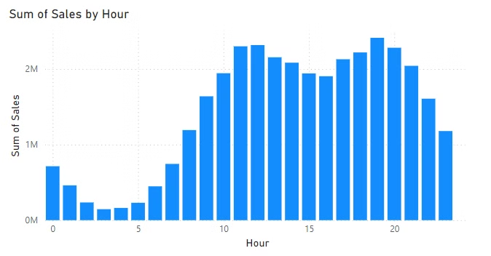
Sales Trends by Hour
1
0-6 AM
Minimal activity
2
10 AM - 9 PM
Peak sales period
3
Resource Alignment
Optimize workforce during peak hours

Slide 6

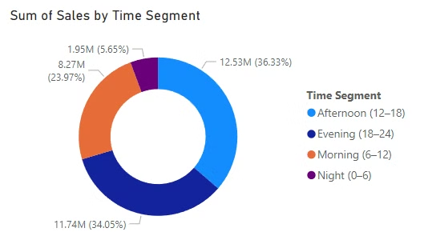
Sales by Time Segment
Afternoon & Evening
Night
Over 70% of sales
Only 5.65% of sales
Strategy
Target advertising in peak segments

Slide 7


Conclusion & Recommendations
Seasonal Marketing
City Expansion
Focus on low-revenue months (Aug-Sep)
Grow in Los Angeles and Dallas
Product Strategy
Resource Optimization
Promote mid-performing items
Align with peak sales hours

